Slide 1

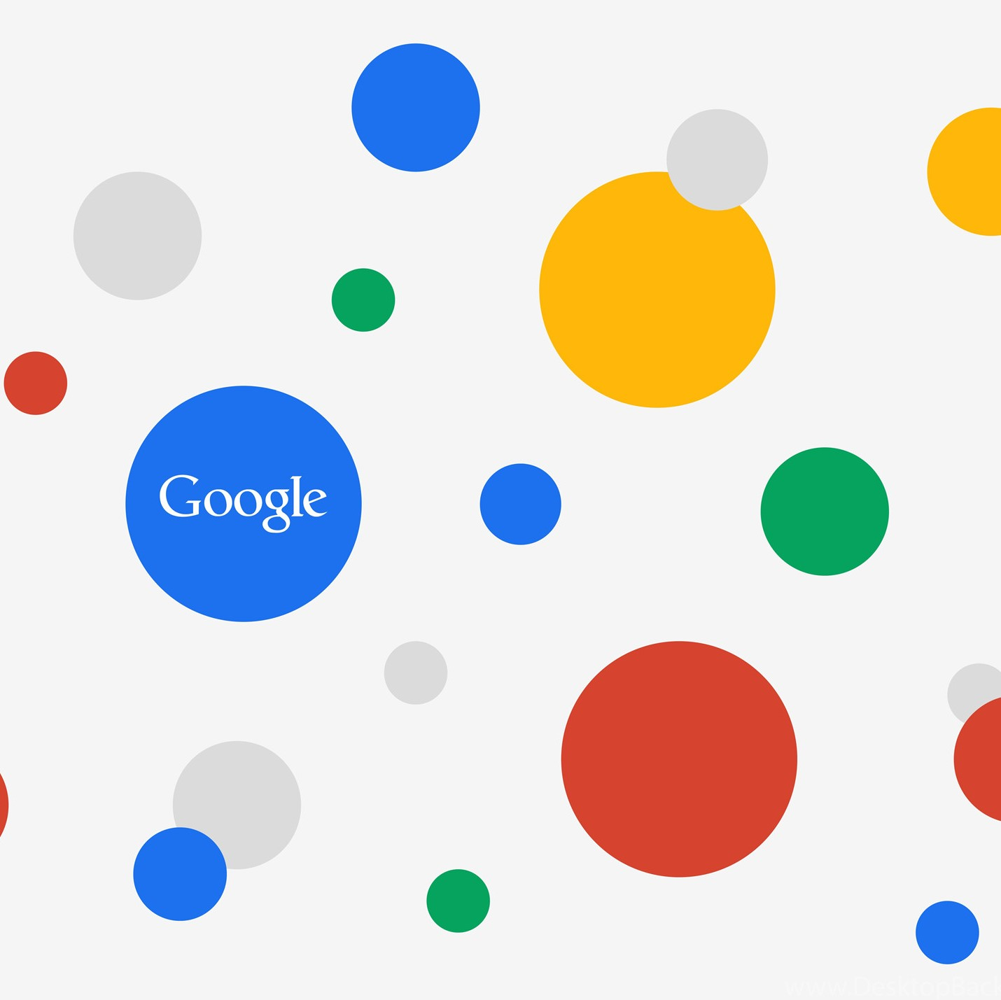
Picture : 4kwallpapers.com
Google trends for data analytics
delivered on Capacity Building Big Data : How to Collect and Analyze
Dhiar Niken Larasati
Jakarta, April 19th 2022

Slide 2

OUTLINE
1
WHAT IS GOOGLE TRENDS?
GOOGLE TRENDS IMPLEMENTATION IN BIG DATA ANALYSIS
(SOME EXAMPLES)
2
HOW TO COLLECT AND ANALYZE GOOGLE TRENDS
(SOME PRACTICES)
3
Picture : pinterest.com

Slide 3
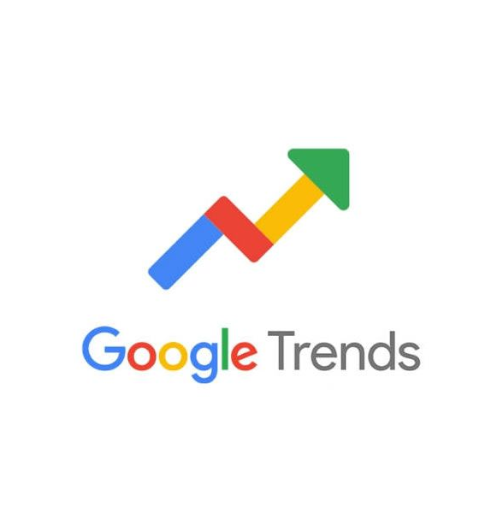
1
WHAT IS GOOGLE TRENDS?

Slide 4
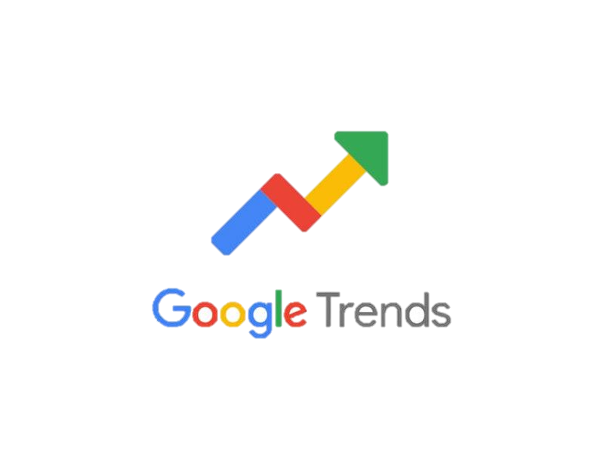
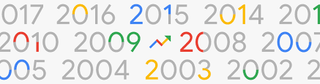
Google Trends provides access to a largely unfiltered SAMPLE OF ACTUAL SEARCH requests made to Google. It’s ANONYMIZED, CATEGORIZED, and AGGREGATED. This allows us to DISPLAY INTEREST IN A PARTICULAR TOPIC from around the globe or down to city-level geography.
Source : https://support.google.com/trends/

Slide 5

GOOGLE TRENDS CHARACTERISTICS
[JUDUL SLIDE SATU BARIS]
1
Real time and non real time
Real time : provide sample covering the last 7 days
Non real time : provide sample from 2004 and up to 36 hours before searching
Sample of search
2
Sample of billions of searches per day, focus on finding insights that can be processed within minutes of a happening event
3
Normalized data
Not a polling data
To make comparisons between terms easier.
Numbers represent search interest relative to the highest point on the chart for the given region and time
4
Reflects the search interest in particular topics.
Should be compared with other data before drawing a conclusion
5
Can compare multiple search interests
Compares up to 5 search interests
Source : https://support.google.com/trends/

Slide 6
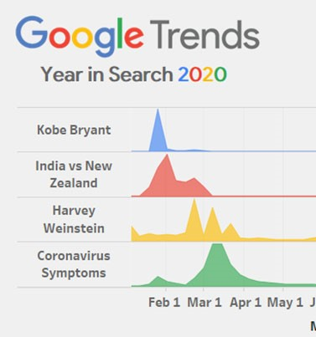
Picture : istockphoto.com
Picture : Roshaan Khan
2
GOOGLE TRENDS IMPLEMENTATION IN BIG DATA ANALYSIS

Slide 7

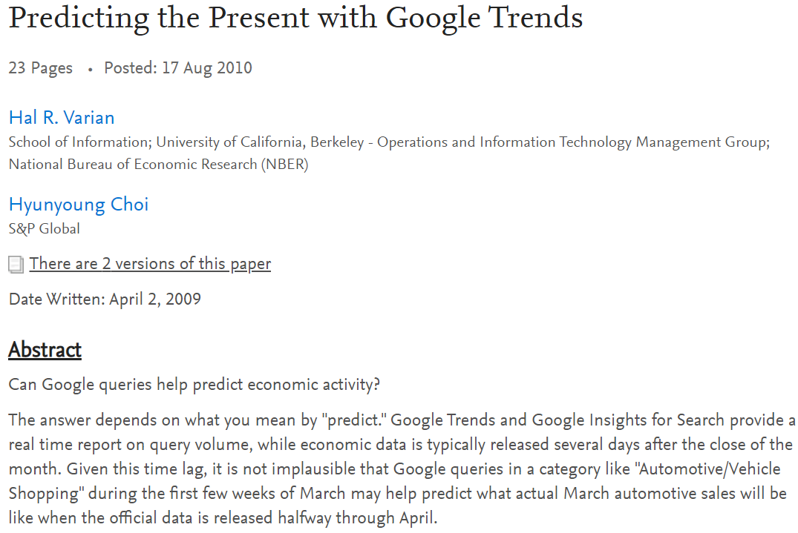
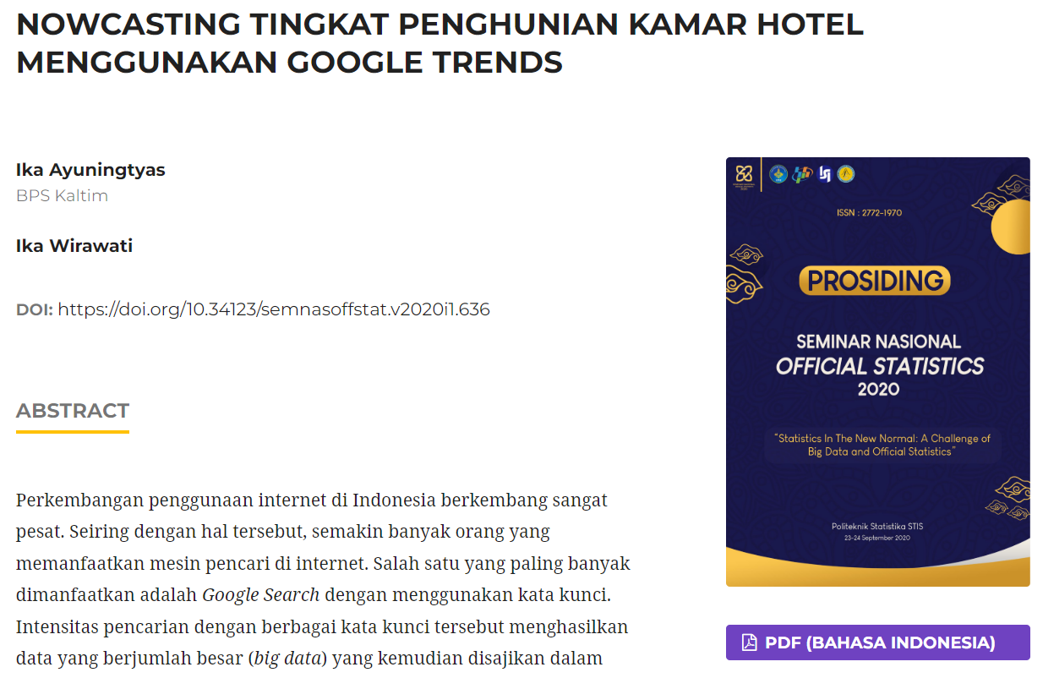
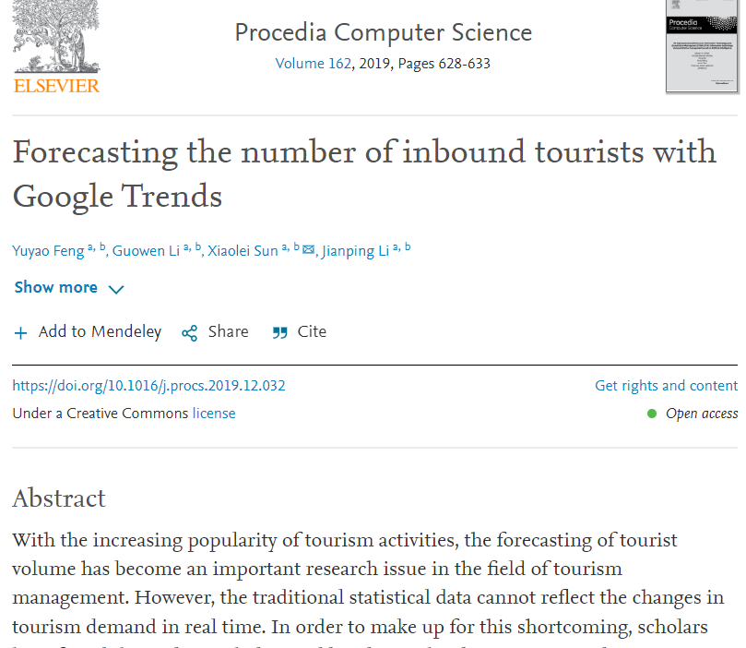
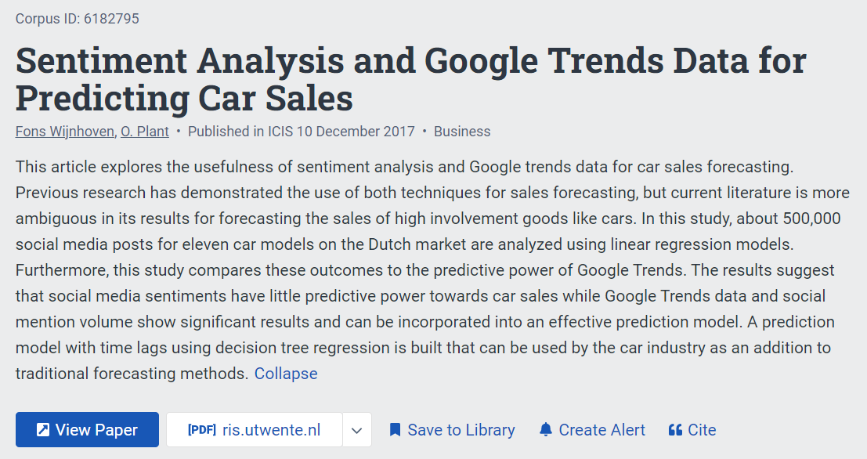
Why Google Trends Index?
[JUDUL SLIDE SATU BARIS]
a feature from Google providing information concerning search requests made to the Google search engine
provides real-time and archived daily, weekly, and monthly data by geographic location and category
considered one of the alternative data that is powerful for predicting, forecasting, moreover for nowcasting.

Slide 8

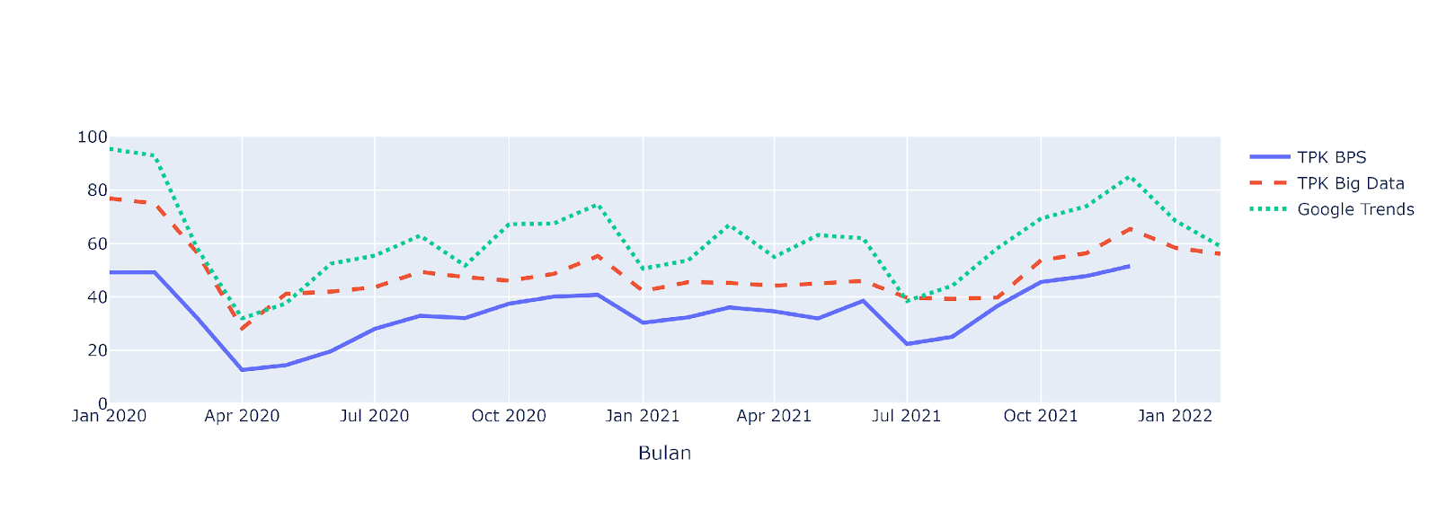
Google trends for validating official statistics and model prediction

Slide 9
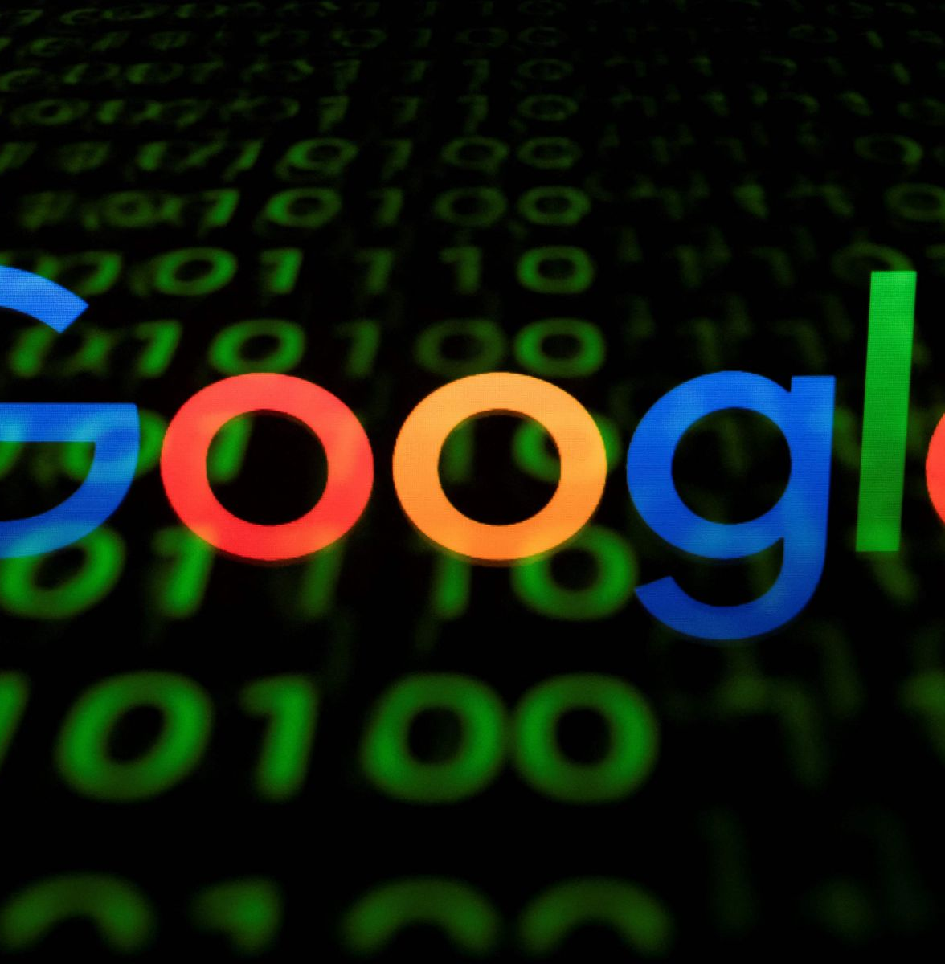
Picture : istockphoto.com
3
HOW TO COLLECT AND ANALYZE GOOGLE TRENDS

Slide 10
1
Download directly from google trends website
2
Run google trends queries in Python
(using Pytrends package)
GOOGLE TRENDS DATA COLLECTION
3
Run google trends queries in R
(using gtrendR package)

Slide 11
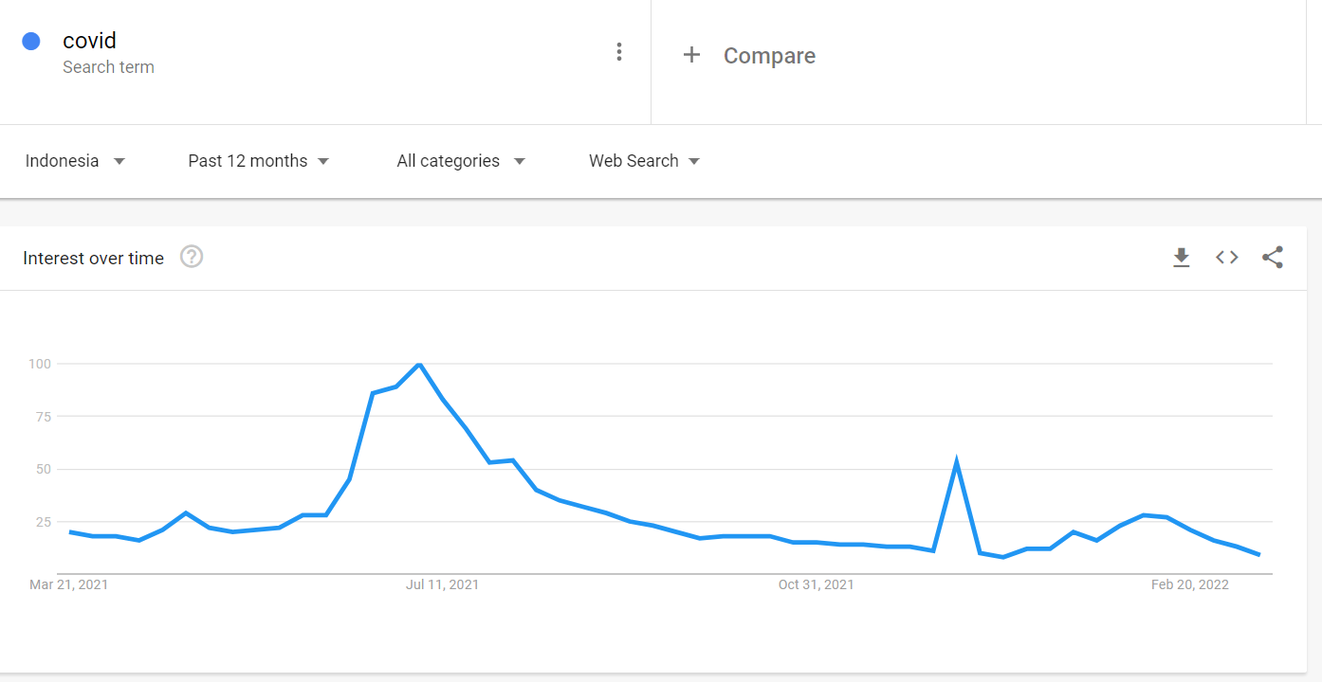
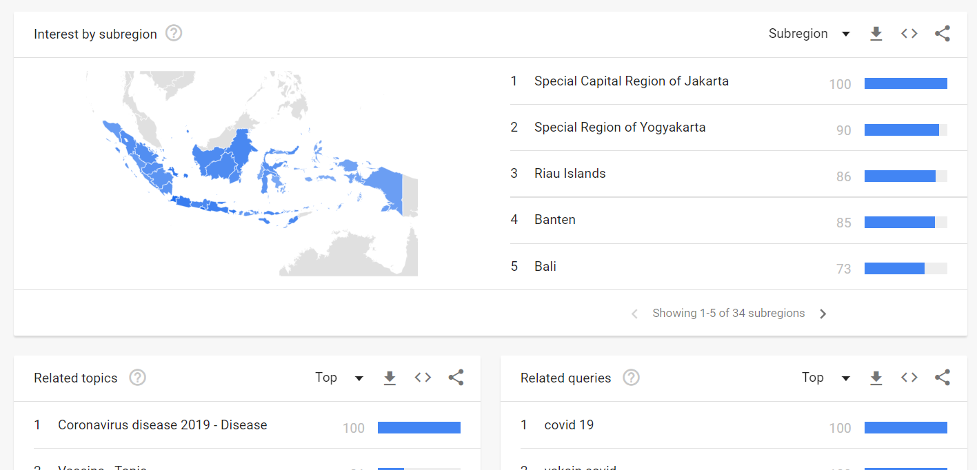
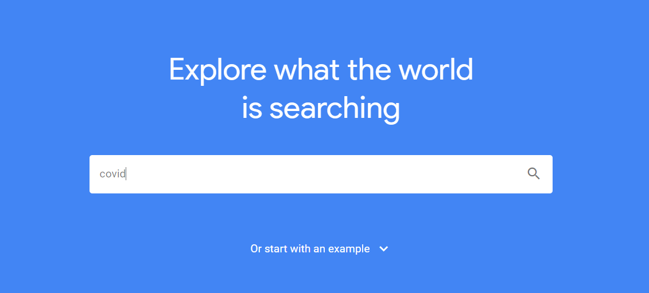
Download directly from google
trends website
[JUDUL SLIDE SATU BARIS]
3
4
2
1
Go to https://trends.google.co.id/
Enter a search term
Select region, period, categories which meet our research
Click download button on the top right
We can also download interest by region, related topics, and related queries as well
We’ll get .csv format data

Slide 12
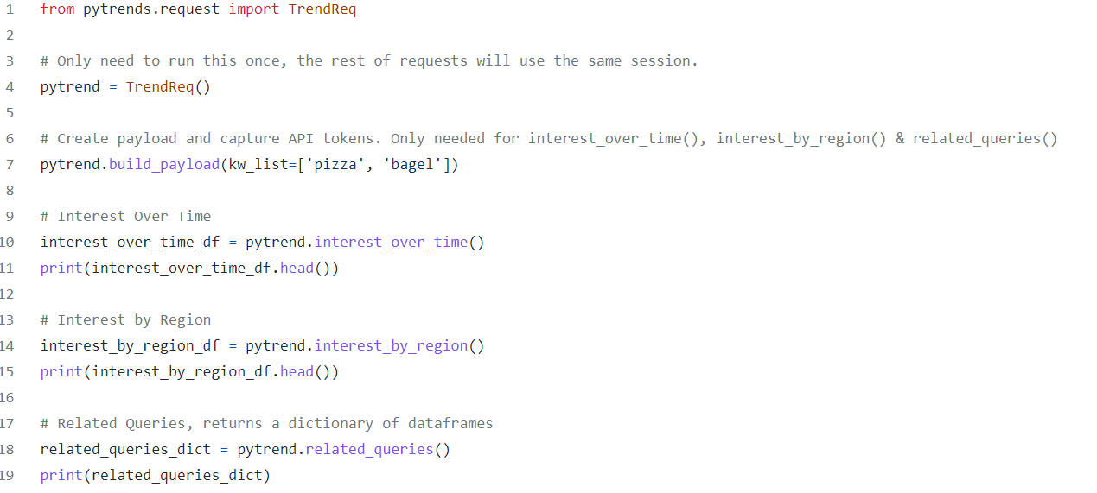
Run google trends queries in Python
(using Pytrends package)
[JUDUL SLIDE SATU BARIS]
Do pip install pytrends
Do some codes to get search interest over time, by region, or related queries
Go to https://github.com/GeneralMills/pytrends or https://pypi.org/project/pytrends/ to get more pytrends details

Slide 13
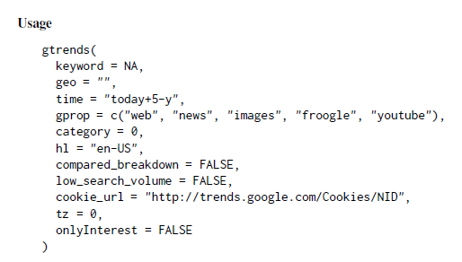
Run google trends queries in R
(using gtrendR package)
[JUDUL SLIDE SATU BARIS]
Do Install.packages(“gtrendsR”)
Do some codes to get search interest over time, by region, or related queries
Go to https://cran.r-project.org/web/packages/gtrendsR/gtrendsR.pdf to get more gtrendsR details

Slide 14
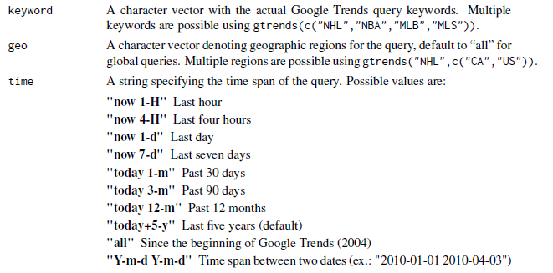
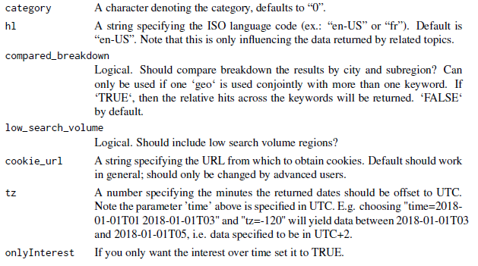
Run google trends queries in R
(using gtrendR package)
[JUDUL SLIDE SATU BARIS]
Some Arguments in gtrends function

Slide 15


Slide 16

Thank you!
Picture : 4kwallpapers.com

